Slide 1
Number Systems
ICT-Lecture 2

Slide 2
Common Number Systems
System | Base | Symbols | Used by humans? | Used in computers?
Decimal | 10 | 0, 1, … 9 | Yes | No
Binary | 2 | 0, 1 | No | Yes
Octal | 8 | 0, 1, … 7 | No | No
Hexa- decimal | 16 | 0, 1, … 9, A, B, … F | No | No

Slide 3
Quantities/Counting (1 of 3)
Decimal | Binary | Octal | Hexa- decimal
0 | 0 | 0 | 0
1 | 1 | 1 | 1
2 | 10 | 2 | 2
3 | 11 | 3 | 3
4 | 100 | 4 | 4
5 | 101 | 5 | 5
6 | 110 | 6 | 6
7 | 111 | 7 | 7

Slide 4
Quantities/Counting (2 of 3)
Decimal | Binary | Octal | Hexa- decimal
8 | 1000 | 10 | 8
9 | 1001 | 11 | 9
10 | 1010 | 12 | A
11 | 1011 | 13 | B
12 | 1100 | 14 | C
13 | 1101 | 15 | D
14 | 1110 | 16 | E
15 | 1111 | 17 | F

Slide 5
Quantities/Counting (3 of 3)
Decimal | Binary | Octal | Hexa- decimal
16 | 10000 | 20 | 10
17 | 10001 | 21 | 11
18 | 10010 | 22 | 12
19 | 10011 | 23 | 13
20 | 10100 | 24 | 14
21 | 10101 | 25 | 15
22 | 10110 | 26 | 16
23 | 10111 | 27 | 17
Etc.

Slide 6
Conversion Among Bases
The possibilities:
Decimal
Octal
Binary
Hexadecimal

Slide 7
Quick Example
25₁₀ = 11001₂ = 31₈ = 19₁₆
Base

Slide 8
Decimal to Decimal
Decimal
Octal
Binary
Hexadecimal

Slide 9
Weight
125₁₀ => 5 x 10⁰ = 5
2 x 10¹ = 20
1 x 10² = 100
125
Base

Slide 10
Binary to Decimal
Decimal
Octal
Binary
Hexadecimal

Slide 11
Binary to Decimal
Technique
  Multiply each bit by 2^{n}, where n is the “weight” of the bit
  The weight is the position of the bit, starting from 0 on the right
  Add the results

Slide 12
Example
Bit “0”
101011₂ => 1 x 2⁰ = 1
1 x 2¹ = 2
0 x 2² = 0
1 x 2³ = 8
0 x 2⁴ = 0
1 x 2⁵ = 32
43₁₀

Slide 13
Exercise
  Convert 10100011 from binary to decimal.
  a) 121
  b) 163
  c) 199
  d) 212

Slide 14
Octal to Decimal
Decimal
Octal
Binary
Hexadecimal

Slide 15
Octal to Decimal
Technique
  Multiply each bit by 8^{n}, where n is the “weight” of the bit
  The weight is the position of the bit, starting from 0 on the right
  Add the results

Slide 16
Example
724₈ => 4 x 8⁰ = 4
2 x 8¹ = 16
7 x 8² = 448
468₁₀

Slide 17
Hexadecimal to Decimal
Decimal
Octal
Binary
Hexadecimal

Slide 18
Hexadecimal to Decimal
Technique
  Multiply each bit by 16^{n}, where n is the “weight” of the bit
  The weight is the position of the bit, starting from 0 on the right
  Add the results

Slide 19
Example
ABC₁₆ => C x 16⁰ = 12 x 1 = 12
B x 16¹ = 11 x 16 = 176
A x 16² = 10 x 256 = 2560
2748₁₀

Slide 20
Decimal to Binary
Decimal
Octal
Binary
Hexadecimal

Slide 21
Decimal to Binary
Technique
  Divide by two, keep track of the remainder
  First remainder is bit 0 (LSB, least-significant bit)
  Second remainder is bit 1
  Etc.

Slide 22
Example
125₁₀ = ?₂
2 125
62 1
2
31 0
2
15 1
2
7 1
2
3 1
2
1 1
2
0 1
125₁₀ = 1111101₂

Slide 23
Decimal to Binary
  Convert 100 from decimal to binary.
  a) 1111100
  b) 1000100
  c) 1100101
  d) 1100100

Slide 24
Octal to Binary
Decimal
Octal
Binary
Hexadecimal

Slide 25
Octal to Binary
Technique
  Convert each octal digit to a 3-bit equivalent binary representation

Slide 26
Example
705₈ = ?₂
7 0 5
111 000 101
705₈ = 111000101₂

Slide 27
Hexadecimal to Binary
Decimal
Octal
Binary
Hexadecimal

Slide 28
Hexadecimal to Binary
Technique
  Convert each hexadecimal digit to a 4-bit equivalent binary representation

Slide 29
Example
10AF₁₆ = ?₂
1 0 A F
0001 0000 1010 1111
10AF₁₆ = 0001000010101111₂

Slide 30
Decimal to Octal
Decimal
Octal
Binary
Hexadecimal

Slide 31
Decimal to Octal
Technique
  Divide by 8
  Keep track of the remainder

Slide 32
Example
1234₁₀ = ?₈
8 1234
154 2
8
19 2
8
2 3
8
0 2
1234₁₀ = 2322₈

Slide 33
Decimal to Hexadecimal
Decimal
Octal
Binary
Hexadecimal

Slide 34
Decimal to Hexadecimal
Technique
  Divide by 16
  Keep track of the remainder

Slide 35
Example
1234₁₀ = ?₁₆
16 1234
77 2
16
4 13 = D
16
0 4
1234₁₀ = 4D2₁₆

Slide 36
Binary to Octal
Decimal
Octal
Binary
Hexadecimal

Slide 37
Binary to Octal
Technique
  Group bits in threes, starting on right
  Convert to octal digits

Slide 38
Example
1011010111₂ = ?₈
1 011 010 111
1 3 2 7
1011010111₂ = 1327₈

Slide 39
Exercise
  Convert 555 from decimal to binary.
  a) 1000101011
  b) 1000111011
  c) 1000101000
  d) 1011101011
1000101011

Slide 40
Binary to Hexadecimal
Decimal
Octal
Binary
Hexadecimal

Slide 41
Binary to Hexadecimal
Technique
  Group bits in fours, starting on right
  Convert to hexadecimal digits

Slide 42
Example
1010111011₂ = ?₁₆
10 1011 1011
B B
1010111011₂ = 2BB₁₆

Slide 43
Quiz 1
Decimal | Binary | Octal | Hexa- decimal
33
 | 1110101
 |  | 703
 |  |  | 1AF
Skip answer
Answer

Slide 44
Exercise – Convert …
Answer
Decimal | Binary | Octal | Hexa- decimal
33 | 100001 | 41 | 21
117 | 1110101 | 165 | 75
451 | 111000011 | 703 | 1C3
431 | 110101111 | 657 | 1AF

Slide 45
Common Powers (1 of 2)
Base 10
Power | Preface | Symbol
10⁻¹² | pico | p
10⁻⁹ | nano | n
10⁻⁶ | micro | μ
10⁻³ | milli | m
10³ | kilo | k
10⁶ | mega | M
10⁹ | giga | G
10¹² | tera | T
Value
.000000000001
.000000001
.000001
.001
1000
1000000
1000000000
1000000000000

Slide 46
Common Powers (2 of 2)
Base 2
Power | Preface | Symbol
2¹⁰ | kilo | k
2²⁰ | mega | M
2³⁰ | Giga | G
Value
1024
1048576
1073741824
What is the value of “k”, “M”, and “G”?
In computing, particularly w.r.t. memory,
the base-2 interpretation generally applies

Slide 47
Binary Addition (1 of 2)
Two 1-bit values
A | B | A + B
0 | 0 | 0
0 | 1 | 1
1 | 0 | 1
1 | 1 | 10
“two”

Slide 48
Binary Addition (2 of 2)
Two n-bit values
  Add individual bits
  Propagate carries
  E.g.,
1
1
10101 21
+ 11001 + 25
101110 46

Slide 49
Multiplication (1 of 3)
Decimal (just for fun)
35
x 105
175
000
35
3675

Slide 50
Multiplication (2 of 3)
Binary, two 1-bit values
A | B | A × B
0 | 0 | 0
0 | 1 | 0
1 | 0 | 0
1 | 1 | 1

Slide 51
Multiplication (3 of 3)
Binary, two n-bit values
  As with decimal values
  E.g.,
1110
x 1011
1110
1110
0000
1110
10011010

Slide 52
Fractions
Decimal to decimal (just for fun)
(10⁻¹= 1/10, 10⁻²=1/100)
3.14 => 4 x 10⁻² = 0.04
1 x 10⁻¹ = 0.1
3 x 10⁰ = 3
3.14

Slide 53
Fractions
Binary to decimal
10.1011 => 1 x 2⁻⁴ = 0.0625
1 x 2⁻³ = 0.125
0 x 2⁻² = 0.0
1 x 2⁻¹ = 0.5
0 x 2⁰ = 0.0
1 x 2¹ = 2.0
2.6875

Slide 54
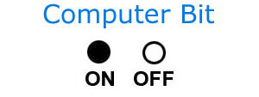
Data Representation
Bits
  The smallest unit of storage
  0 and 1 are called bits (short for binary digits)
Bytes
  Eight bits grouped together as a unit
1 0

Slide 55
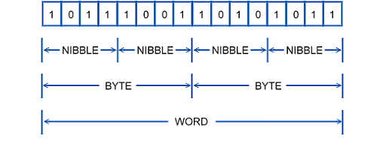
The Whole Picture
Bit

Slide 56
Representation of Negative Numbers in Binary
The leftmost digit of the number is used as a special value to represent the sign of the number:
0 = positive, 1 = negative
For example,
Positive 12 (Decimal) = 01100
Negative 12(Decimal) = 111000

Slide 57
Computer Codes
ASCII
  American Standard Code for Information Interchange
  A Character Encoding standard for electronic communication.

Slide 58
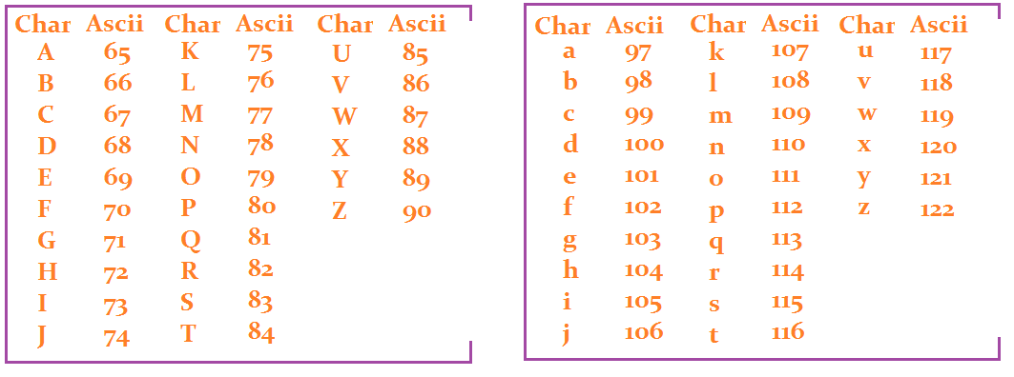
Contd..

Slide 59
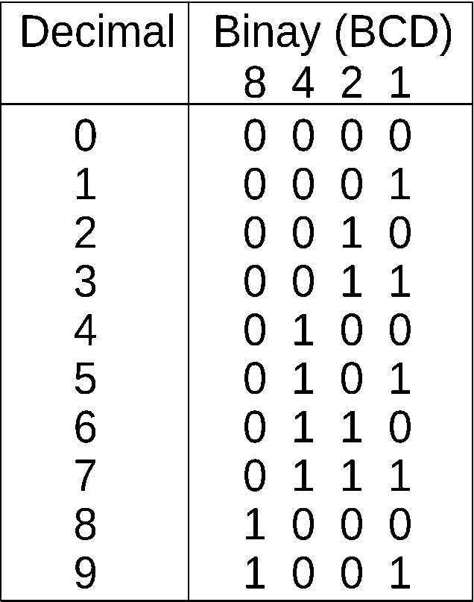
Computer Codes
BCD
  Binary Coded Decimal
  Assigns a four-digit binary code to each digit

Slide 60
Computer Codes
UNICODE
  An international encoding standard for use with different languages and scripts
  Each letter, digit, or symbol is assigned a unique numeric value that applies across different platforms and programs.
  Often, while reading about Unicode you will encounter acronyms such as UCS-*, UTF-*, and BOM.

Slide 61
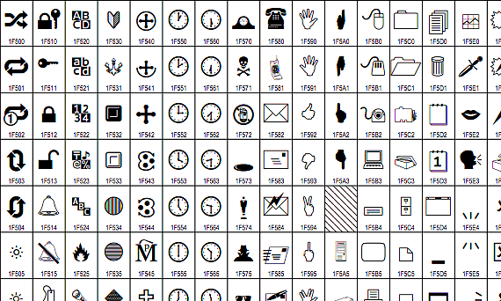
Contd..

Slide 62
End of Lecture

